Slide 1
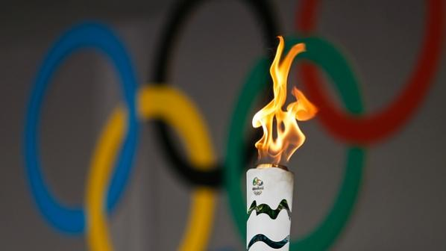
The Olympics Throughout The Years
Annie Trieu, Eric Moeller, Griffin Miller, Mollie Sobel, Noah Reyna

Slide 2

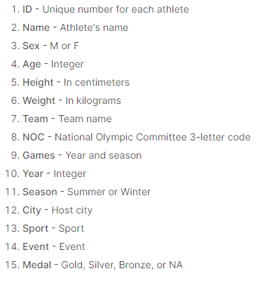
Dataset
We focused on extracting both aspects to get insights on:
Average bodily statistics of participants
Country participation and winnings in the games
Women’s participation

Slide 3

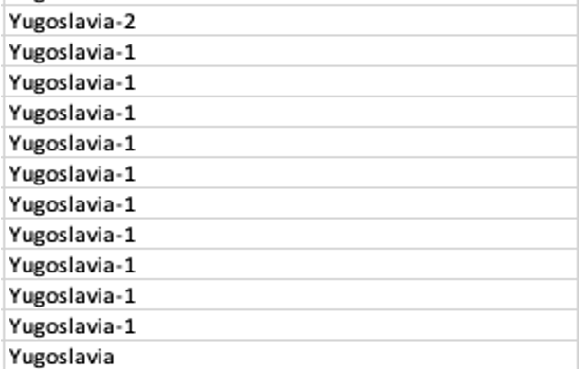
Challenges With Cleaning Data
3% of our data did not contain age values - converted ‘NA’ to null
20% of our data did not contain height/weight values - converted from ‘NA’ to null
Majority from 1948-1952
Some team names contained numbers
Used ‘NOC’ column instead

Slide 4
Insights
Valuable Information Extracted

Slide 5

Women’s Participation

Slide 6
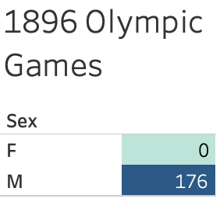
The History of Women’s Participation in the Games
When the Olympics first began in 1896, there were no women participants.
This was the only year in which women did not participate

Slide 7
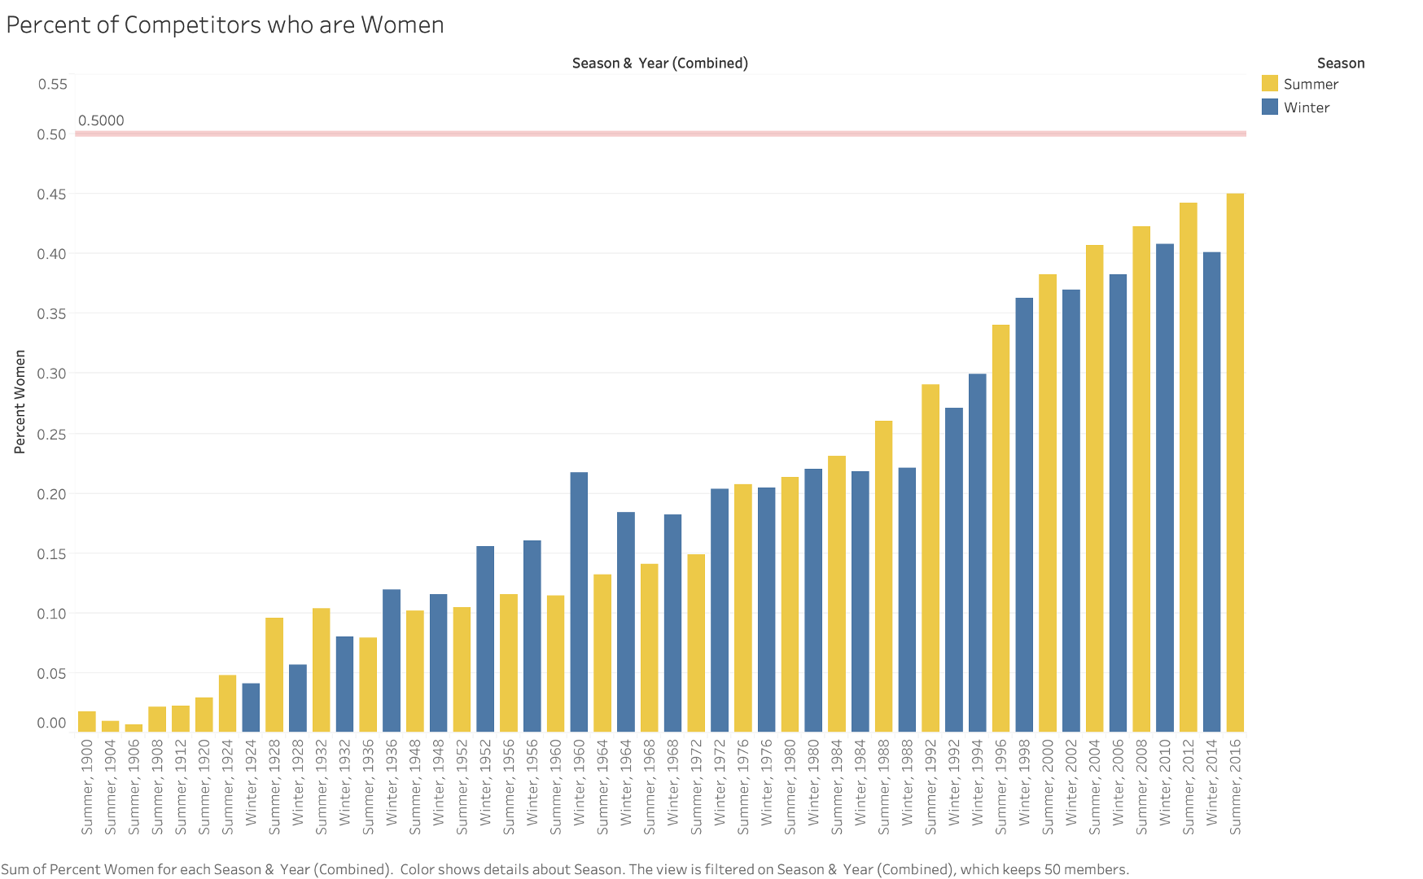
Rise of Women’s Participation

Slide 8
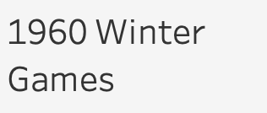
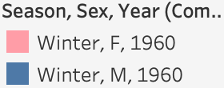
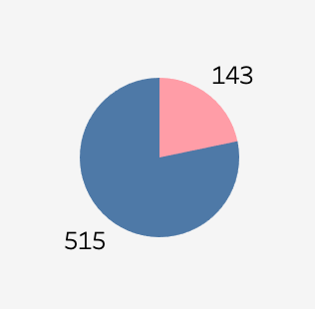
Rise of Women’s Participation
The threshold of 20% of athletes being women was not reached until 1960
Over 60 years since the Olympics began
Was progress really made?
21.73%

Slide 9
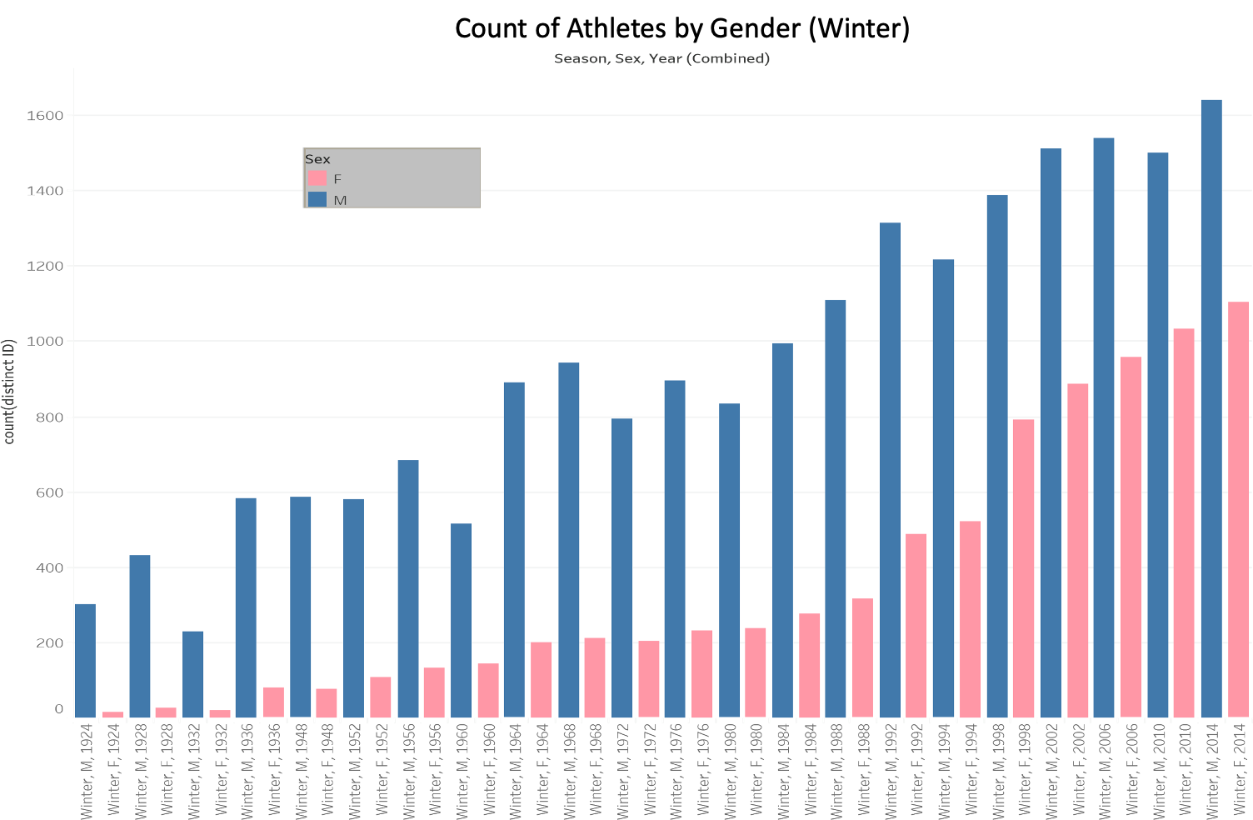
Not so fast...
For the first and only time in Olympic History, the men's bobsleigh was not included in the 1960 Winter Games, eliminating roughly 120 men from participating in the games
Women’s participation in terms of number of athletes remained relatively the same

Slide 10
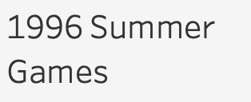
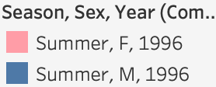
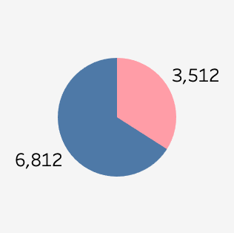
Rise of Women’s Participation
The threshold of ⅓ of athletes being women was not reached until 1996
100 years since the first Olympic Games
34.02%

Slide 11
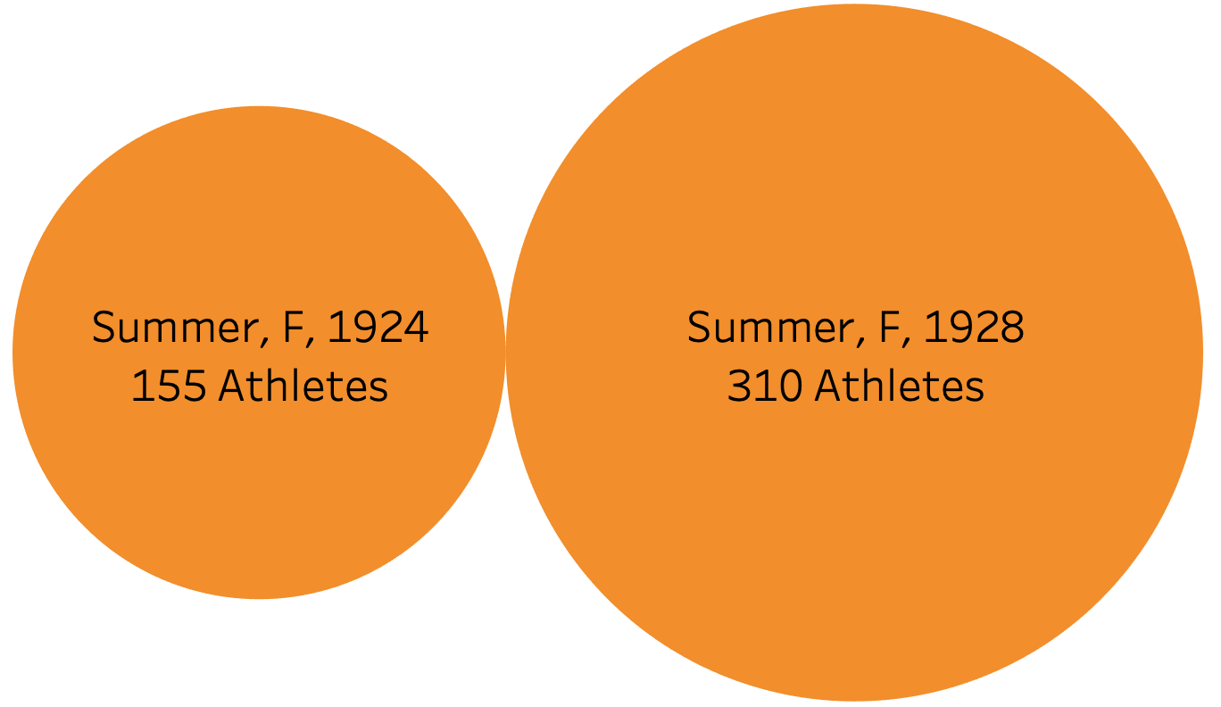
Pivotal Moments for Women’s Participation
1928 - Women were allowed to participate in Track and Field as well as Gymnastics
Two sports with large number of athletes
Doubled the amount of women competitors from the 1924 Games

Slide 12
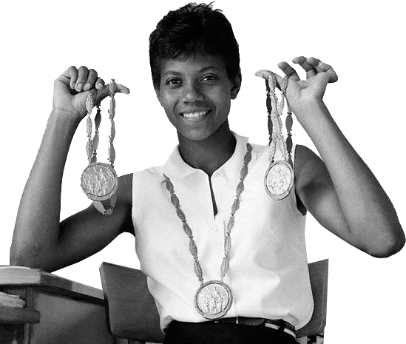
Pivotal Moments for Women’s Participation
1960 Summer Games - One of the most iconic women athletes in American history, Wilma Rudolph, took home 3 gold medals in Track and Field
First globally televised Olympics
Set the stage for all women athletes to follow

Slide 13
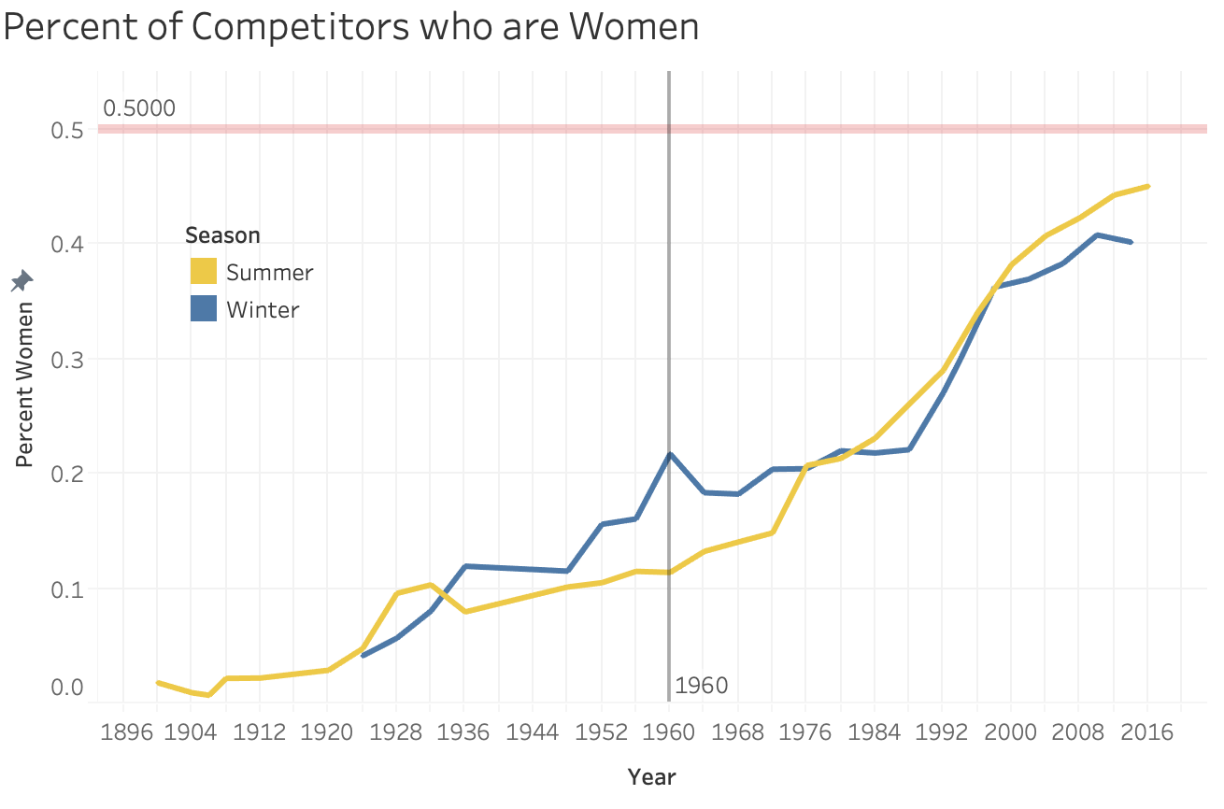

Slide 14
Male-/Female-exclusive Sports
Male-only
Female-only
Aeronautics
Baseball
Basque Pelota
Cricket
Jeu De Paume
Lacrosse
Military Ski Patrol
Nordic Combined
Polo
Racquets
Roque
Rugby
Tug-Of-War
Rhythmic Gymnastics
Synchronized Swimming
Softball
2014/2016

Slide 15
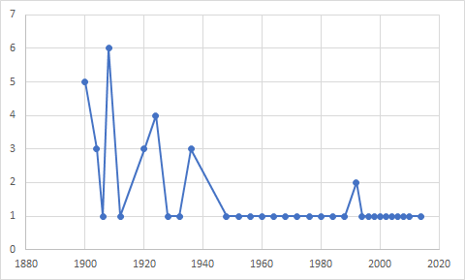
Number of Male-only Olympic Sports over Time
1992

Slide 16
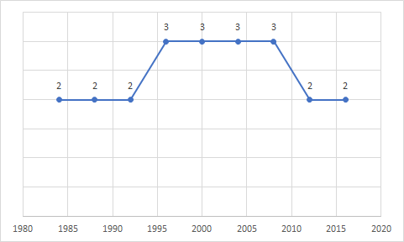
Number of Female-only Olympic Sports over Time
1996-2008

Slide 17
Athlete's Average
Age/Height/Weight

Slide 18
Average Age/Height/Weight
Average per Sport | Male | Female
Yougest | Lacrosse (16.11 years) | Rhythmic Gymnastics (18.74 years)
Oldest | Roque (40 years) Polo (33.57 years) | Alpinism (43 years) Equestrian (34.187 years)
Shorest | Gymnastics (167.63 cm) | Gymnastic (156.15 cm)
Tallest | Basketball (194.88 cm) | Basketball (182.45 cm)
Heaviest | Tug-of-War (95.49 kg)* Basketball (91.71 kg) | Basketball (73.68 kg)
Lightest | Gymnastics (63.34 kg) | Gymnastics (47.78kg)
*Male only sport from 1900-1920

Slide 19
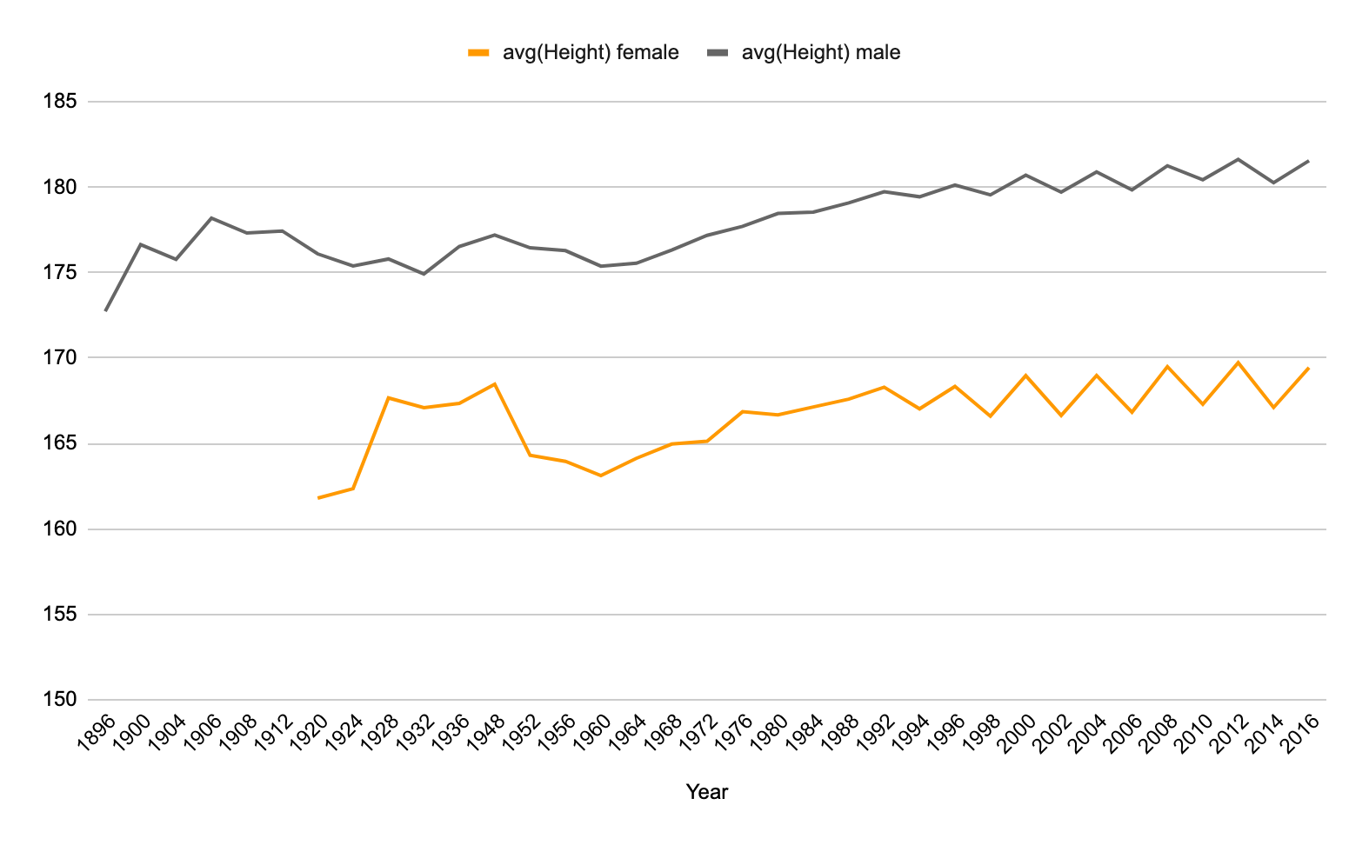
Note: Drop in 1960 possibly due to draft
Data set had less data for these years
Average Height Trend

Slide 20
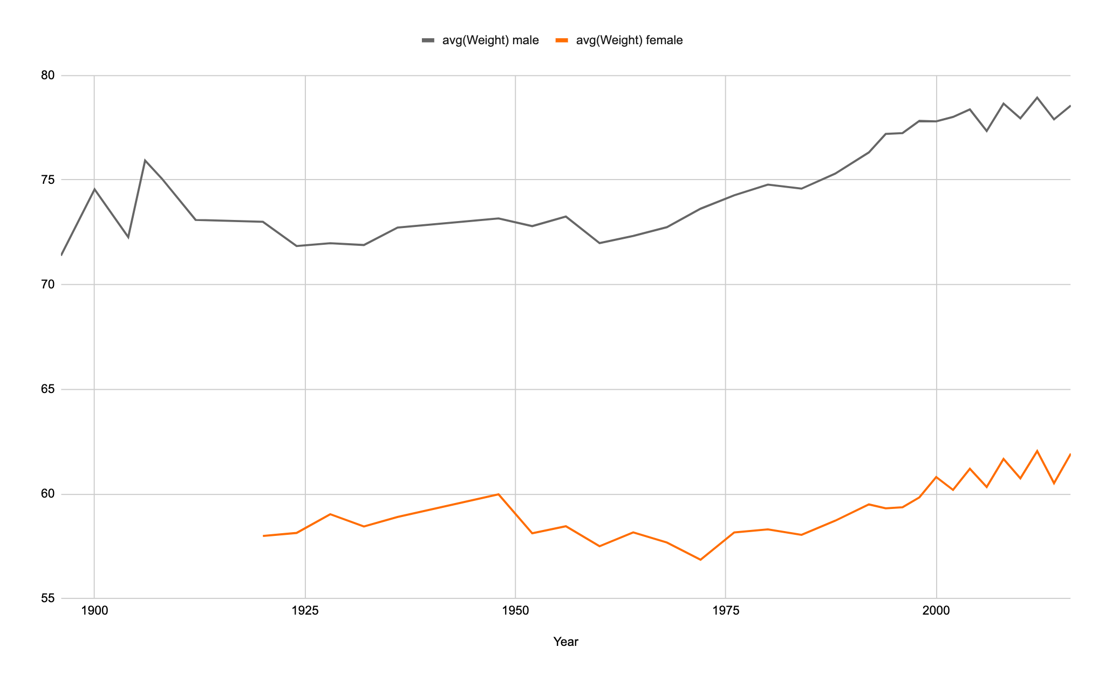
Average Weight Trend

Slide 21
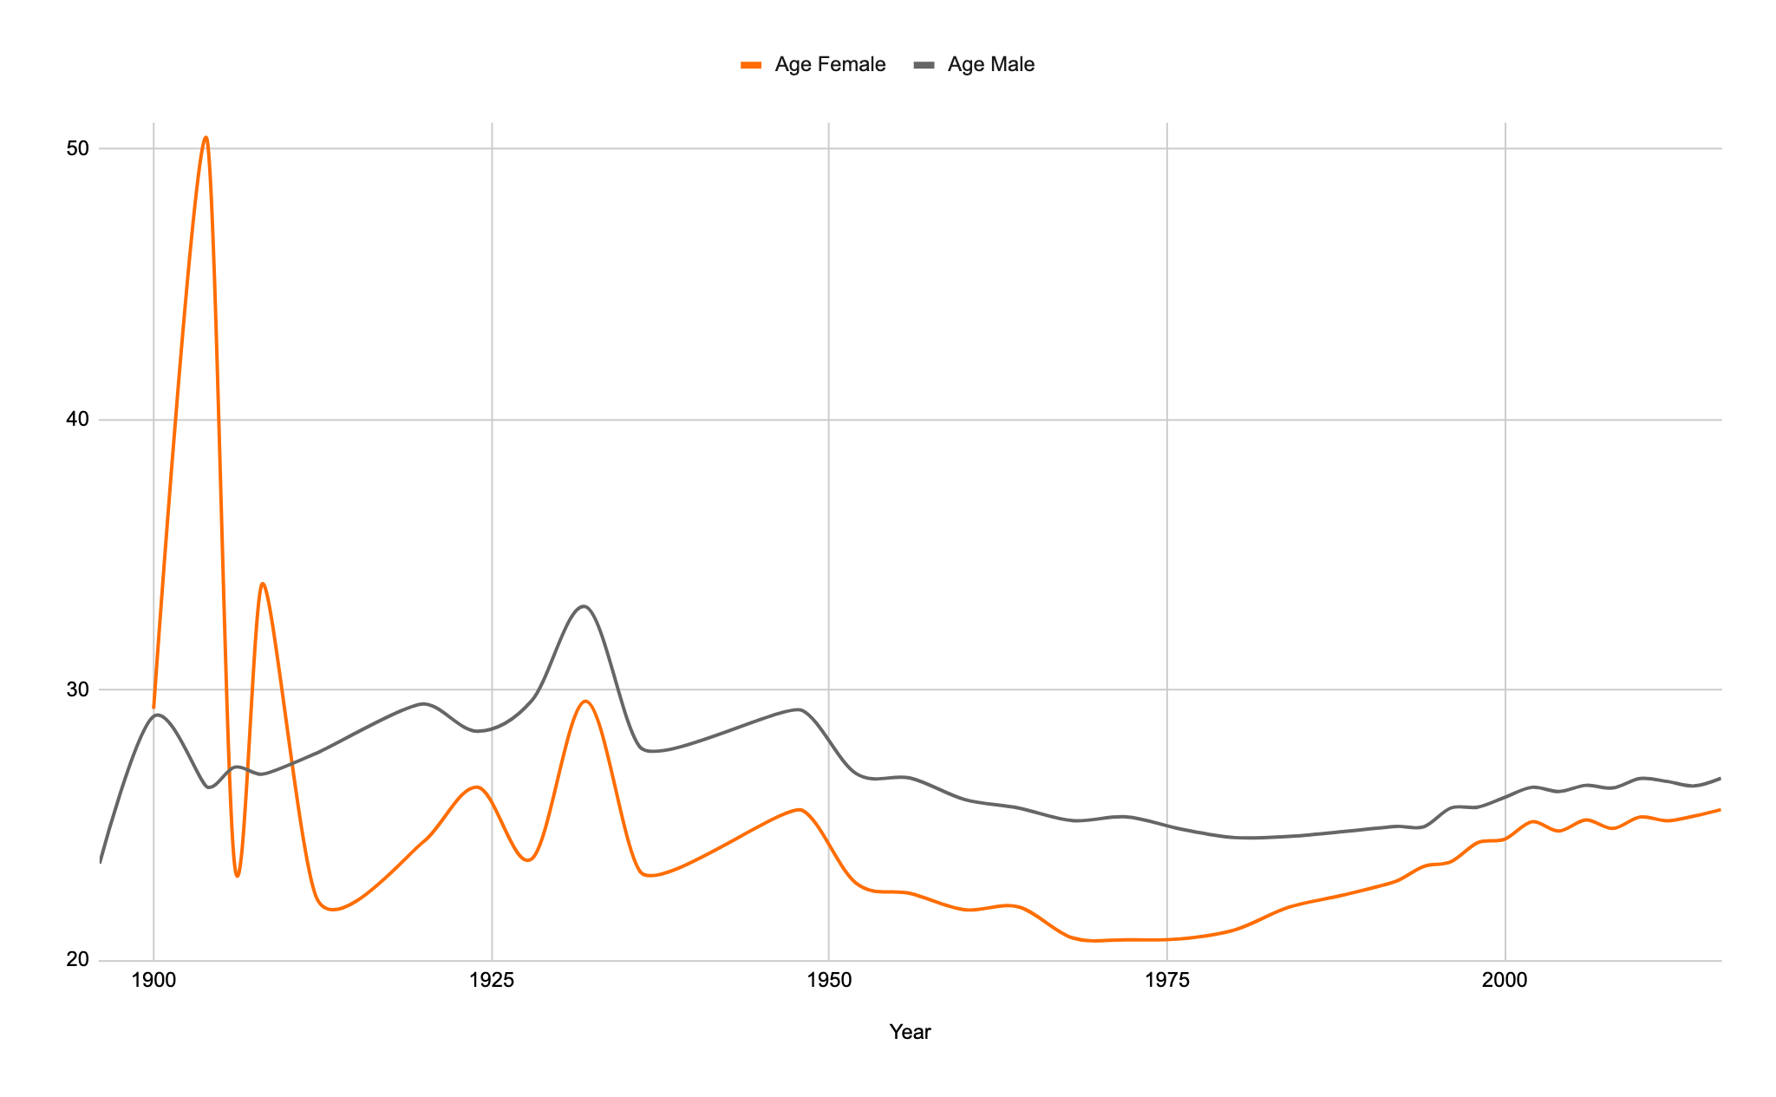
Average Age Trend

Slide 22
Country Analysis

Slide 23
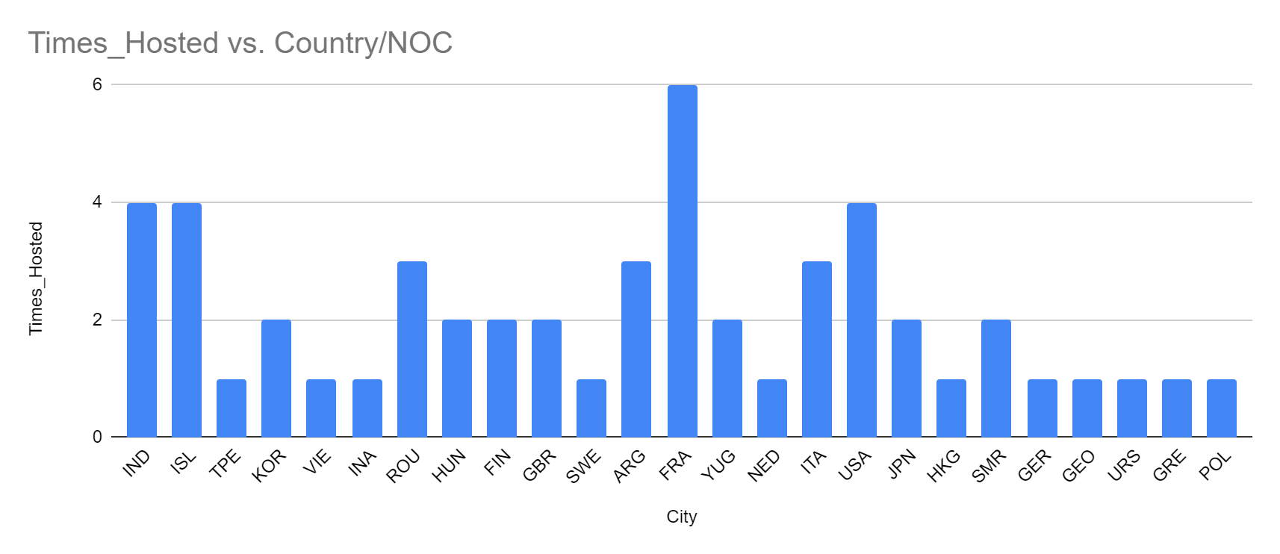
Number of Times a Country Has Hosted

Slide 24
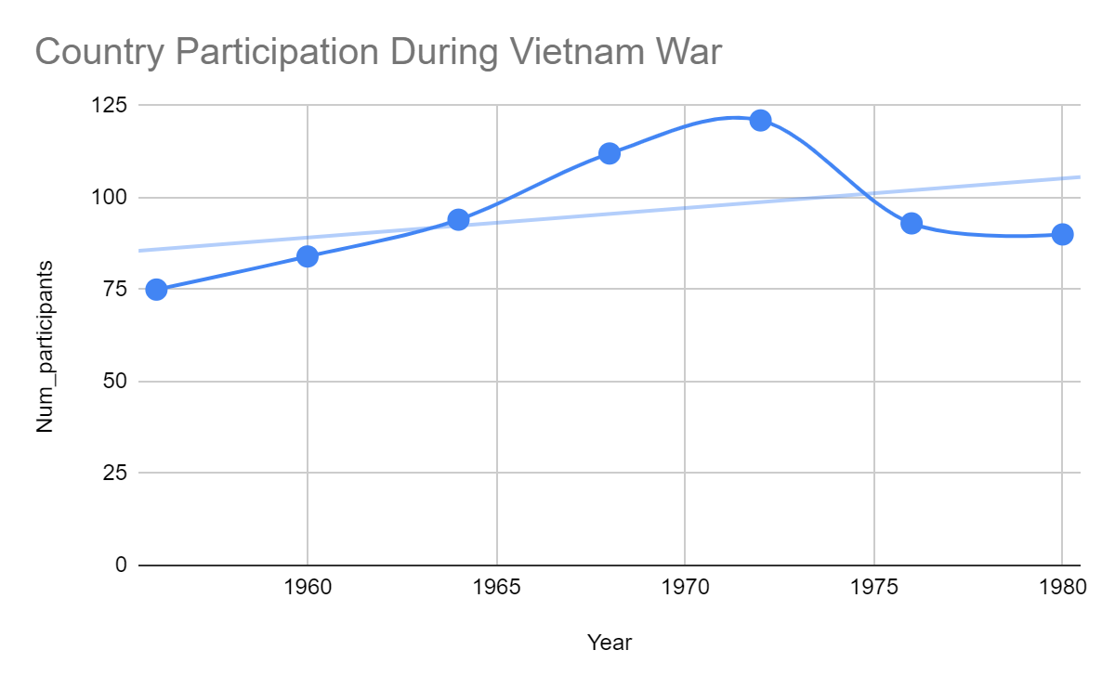
Country Participation During Vietnam War

Slide 25
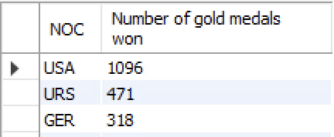
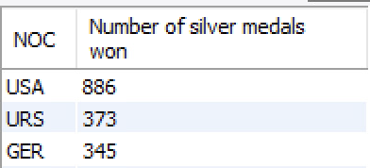
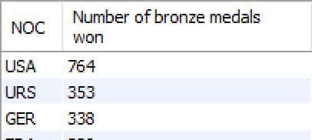
Top performing countries

Slide 26
Athletes Performance (Top 5)
Name | Country | Sports | Gold Medals Won
Michael Phelps | USA | Swimming | 23
Raymond Clarence | USA | Athletics | 10
Frederick Carlton | USA | Athletics | 9
Larysa Semenivna | USSR | Gymnastics | 9
Mark Andrew Spitz | USA | Swimming | 9
*Including Intercalated Games

Slide 27

Strategic Value
Analysis of Beneficiaries & Our Data’s Impact

Slide 28

Sports Historian
Occupations
College professors
Journalists
Documentary filmmakers
Gender Activists
Trends to look at
Age/Height/Weight
Individual Athlete Medalists
Proportion of medals a country won over time
Country participations
Especially during world events (ie: wars)
Female involvement
Gap in gender participation by sport

Slide 29
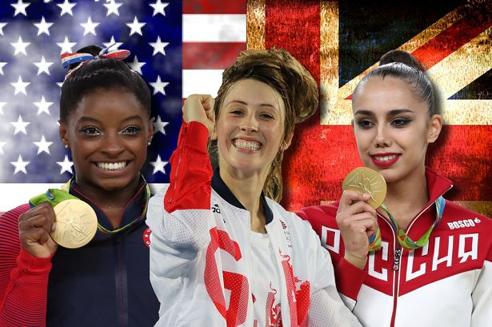
Athletes
A way to keep track of how athletes perform over time
Case studies for future athletes
Implementation what successful athletes did
Improve training program for athletes

Slide 30
Additional Data Needed

Slide 31
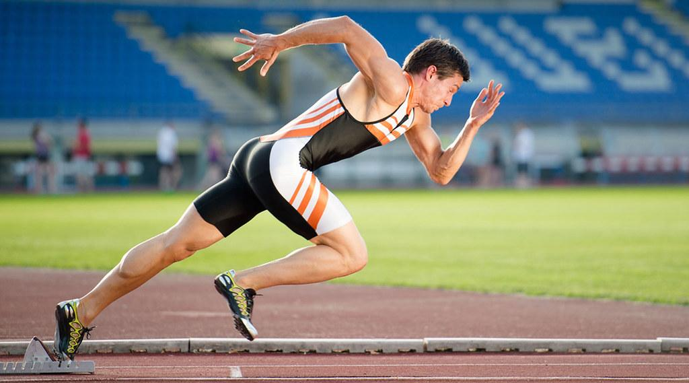
Detailed Athlete Data
Other athletes in family
Home country vs. competing country
Age they began training
Other sports played
Notes:
While it would be interesting to have access to this information, much of it would not be quantifiable enough to contribute meaningfully to data analysis.

Slide 32
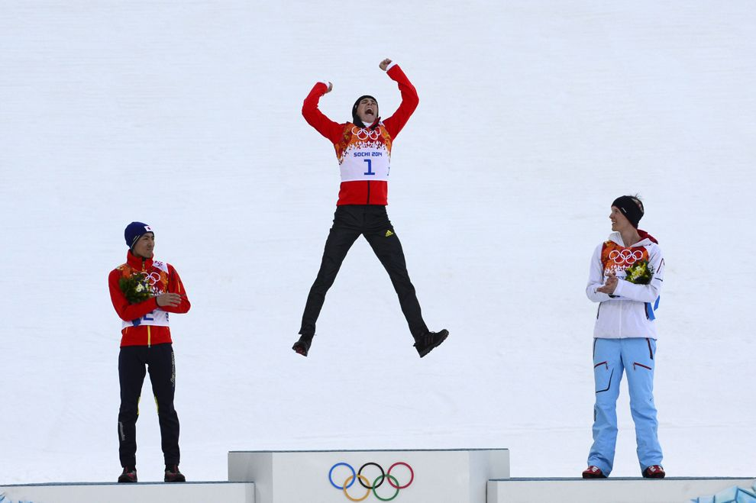
Detailed Result Data
Particular scores/times
More useful for analysis within specific sports
Difficult to clean/normalize across events
Notes:
Data on particular scores and times would be more helpful than relative rankings to analyze how raw performance has changed over time. Because this data would be impossible to compare across sports, it would be most appropriate to create new tables for specific events.

Slide 33
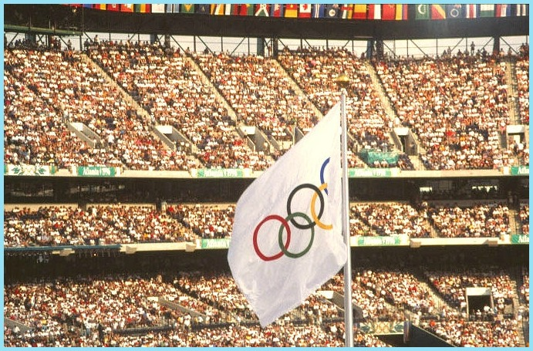
Viewer Data
Which events draw the most viewers?
Which games did viewers most enjoy watching?
Do these correlate with the success of specific countries/athletes?
Notes:
Viewer data such as audience size and television ratings would be helpful in determining which sports and events contribute most to the success of the Olympics as a global spectacle, and it would be interesting to analyze how this success correlates with the performances of specific countries or athletes.

Slide 34
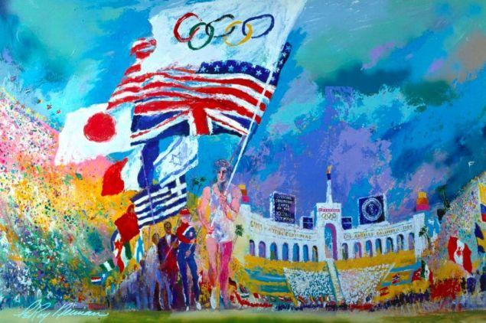
Questions?

Slide 35

Appendix

Slide 36
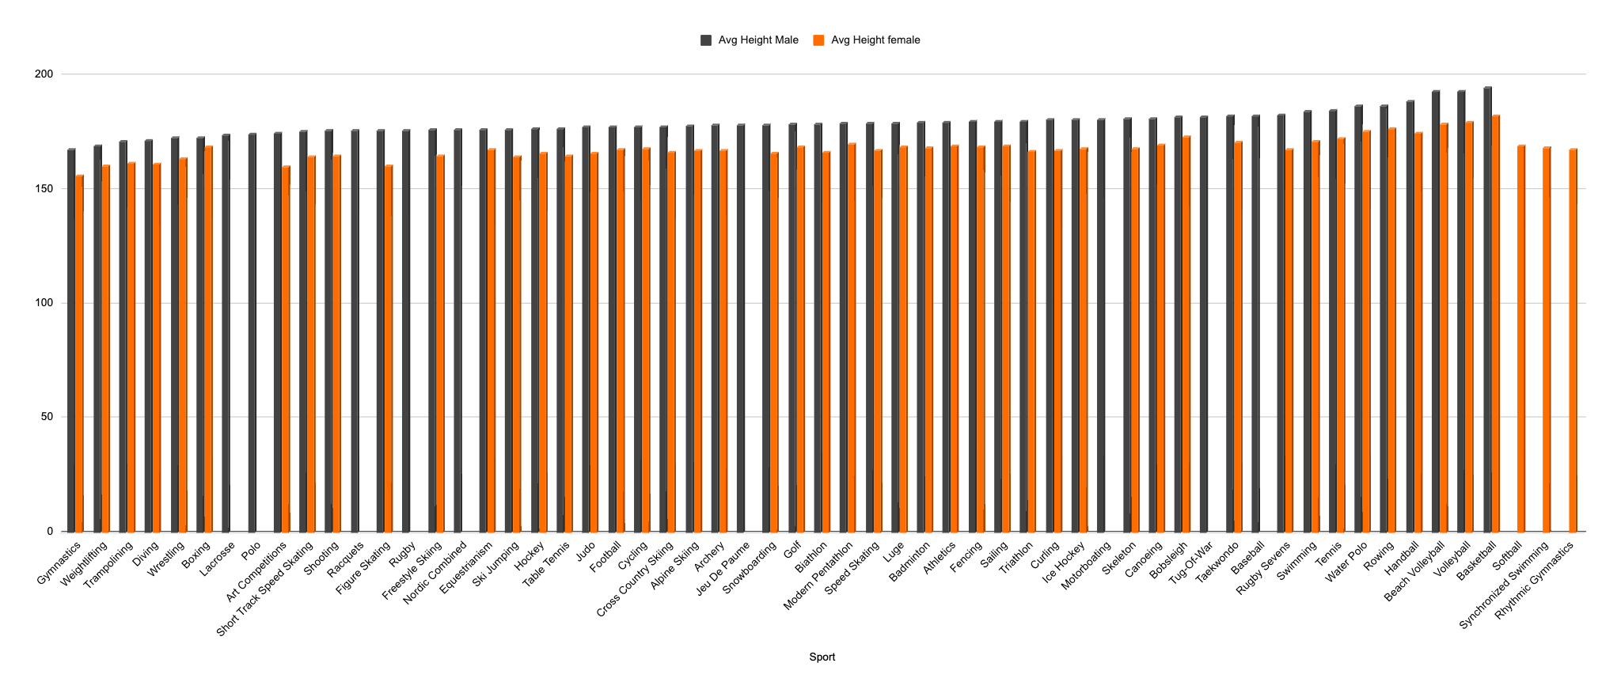
Average Height per Sport

Slide 37
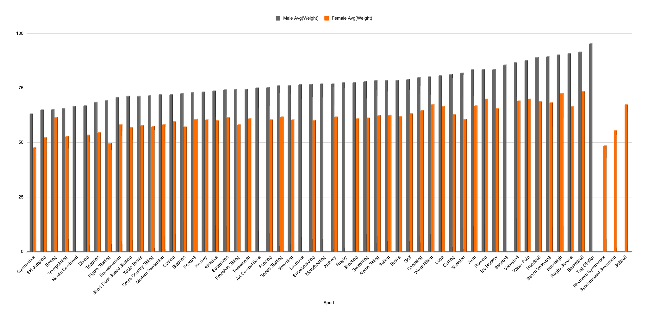
Average Weight per Sport

Slide 38
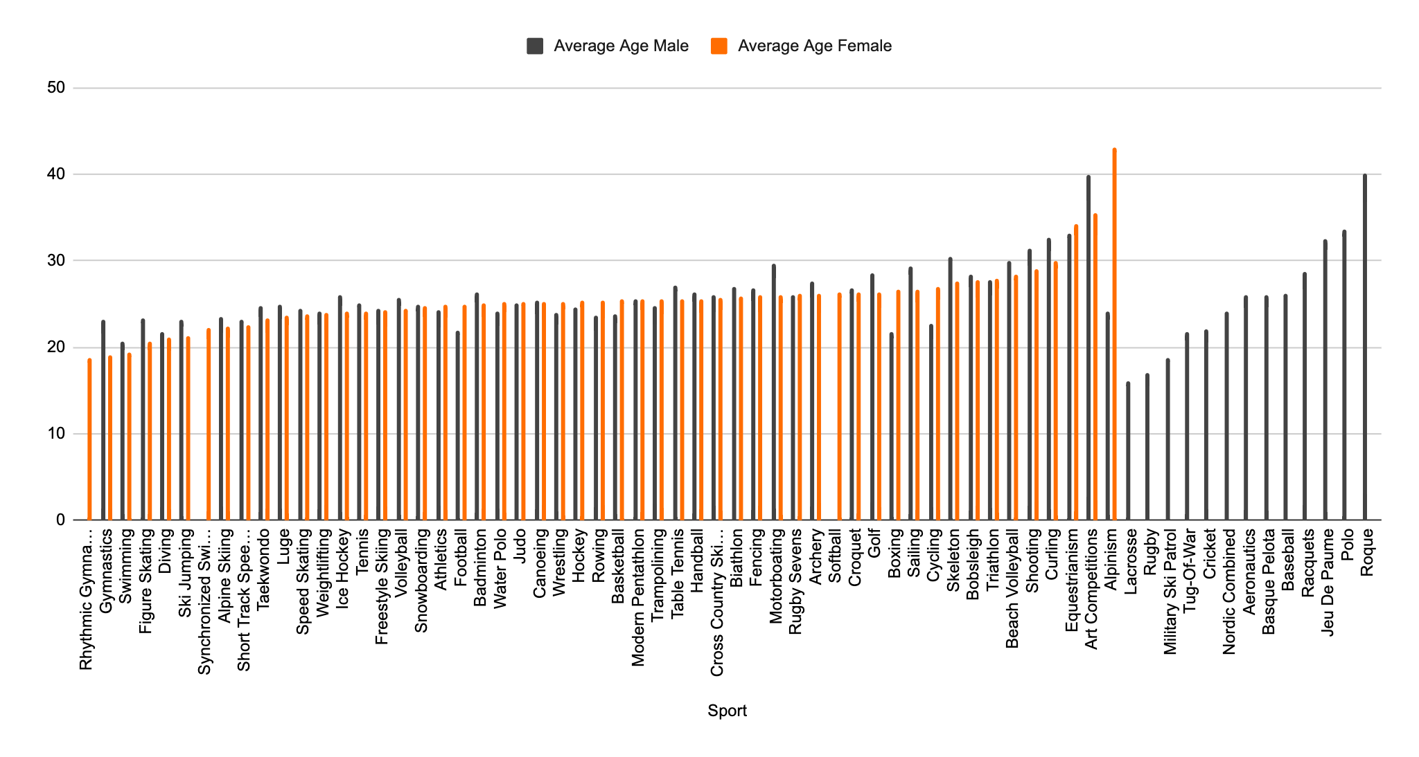
Average Age per Sport

Slide 39
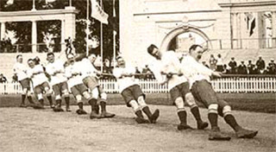
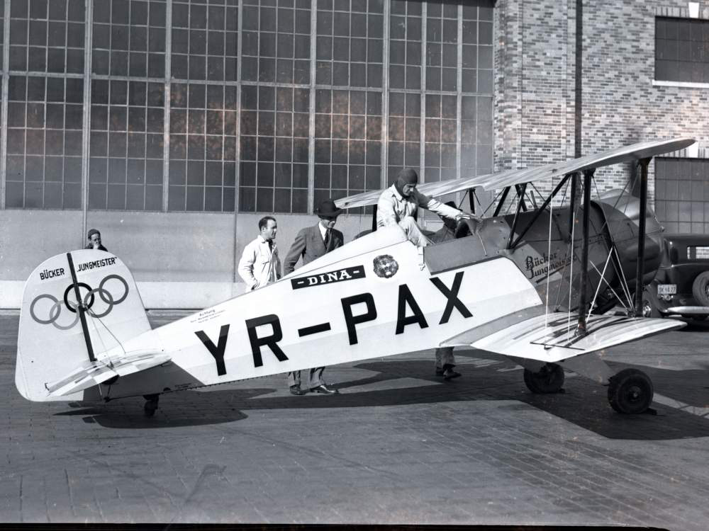
Unique Events in Olympic History
Art Competitions (Music, Painting, Sculpting, Architecture)
1912-1948
Tug-of-War
1900-1920, Men only
Military Ski Patrol
1924, Men only
Aeronautics
1936
Notes:
Viewer data such as audience size and television ratings would be helpful in determining which sports and events contribute most to the success of the Olympics as a global spectacle, and it would be interesting to analyze how this success correlates with the performances of specific countries or athletes.

Slide 40
Queries - Women’s Participation
create mens only table
create table men_particpants
select year, season, count(distinct ID) as participants
from athlete_events
where Sex = 'M'
group by year, season
order by year;
create women’s only table
create table women_particpants
select year, season, count(Distinct ID) as participants
from athlete_events
where Sex = 'F'
group by year, season
order by year;
create new table showing percent of women in each year
create table percent_women_complete
select m.year, m.season, (w.participants / (m.participants + w.participants)) as percent_women
from women_particpants as w
inner join men_particpants as m
on w.year = m.year and w.season = m.season
group by m.year, m.season, (w.participants / (m.participants + w.participants))
order by percent_women desc;
Winter only table
create table percent_women_winter
select m.year, m.season, (w.participants / (m.participants + w.participants)) as percent_women
from women_particpants as w
inner join men_particpants as m
on w.year = m.year and w.season = m.season
where m.season = 'winter'
group by m.year, m.season, (w.participants / (m.participants + w.participants))
order by percent_women desc;
Summer only table
create table percent_women_summer
select m.year, m.season, (w.participants / (m.participants + w.participants)) as percent_women
from women_particpants as w
inner join men_particpants as m
on w.year = m.year and w.season = m.season
where m.season = 'summer'
group by m.year, m.season, (w.participants / (m.participants + w.participants))
order by percent_women desc;
In what year were women 50% of the competing population?
select *
from percent_women_complete
where percent_women > .5;
#none

Slide 41
Queries - Gender-exclusive Sports
Create table to show male/female proportions
create table percent_male_female_sports
select sport,
count(case when sex="M" then 1 end) as males,
count(case when sex="F" then 1 end) as females,
count(*) as total,
count(case when sex="M" then 1 end)/count(*) as perc_male,
count(case when sex="F" then 1 end)/count(*) as perc_female
from athlete_events
group by sport
order by perc_male desc;
Create table to show male participation in sports over time
create table male_sports_over_time
select sport, year, count(*)
from athlete_events
where sex="M"
group by sport, year
order by sport;
Create table to show female participation in sports over time
create table female_sports_over_time
select sport, year, count(*)
from athlete_events
where sex="F"
group by sport, year
order by sport;
Identify male-exclusive sports
select m.sport
from male_sports_over_time m
left join female_athletes_over_time f on f.sport=m.sport
where f.sport is null;
Identify female-exclusive sports
select f.sport
from female_sports_over_time f
left join male_athletes_over_time m on m.sport=f.sport
where m.sport is null;

Slide 42
Queries - Athlete Height/Age/Weight
Average Female Height
select Sport, avg(Height)
from athlete_events
where Sex = "F" and Height != 0
group by Sport
order by avg(Height);
Average Male Height
select Sport, avg(Height)
from athlete_events
where Sex = "M" and Height != 0
group by Sport
order by avg(Height);
Average Female Height per Year
select avg(Height), Year
from athlete_events
where Sex = "F" and Height != 0
group by Year
order by Year;
Average Male Height per Year
select avg(Height), Year
from athlete_events
where Sex = "M" and Height != 0
group by Year
order by Year;
Average Female Weight
select Sport, avg(Weight)
from athlete_events
where Sex = "F" and Weight != 0
group by Sport
order by avg(Height);
Average Male Weight
select Sport, avg(Weight)
from athlete_events
where Sex = "M" and Weight != 0
group by Sport
order by avg(Height);
Average Female Weight per Year
select avg(Weight), Year
from athlete_events
where Sex = "F" and Weight != 0
group by Year
order by Year;
Average Male Weight per Year
select avg(Height), Year
from athlete_events
where Sex = "M" and Weight != 0
group by Year
order by Year;
Average Female Age
select Sport, avg(Age)
from athlete_events
where Sex = "F" and Age != 0
group by Sport
order by avg(Age);
Average Male Age
select Sport, avg(Age)
from athlete_events
where Sex = "M" and Age != 0
group by Sport
order by avg(Age);
Average Female Age per Year
select avg(Age), Year
from athlete_events
where Sex = "F" and Age != 0
group by Year
order by Year;
Average Male Age per Year
select avg(Age), Year
from athlete_events
where Sex = "M" and Age != 0
group by Year
order by Year;

Slide 43
Queries - Country Info
Countries Participating in 1896 vs Now
select Year, count(distinct NOC) as num_teams
from athlete_events
where year = '1896';
select Year, count(distinct NOC) as num_teams
from athlete_events
where year = '2016';
Number of Times a Country Has Hosted
select NOC, count(distinct Year) as times_hosted
from athlete_events
group by city
order by count(year) desc;
Countries’ Participation During Major World Events
WW1:
select count(distinct NOC) as count_Team
from athlete_events
where year = 1916;
WWII:
select count(distinct NOC) as count_Team
from athlete_events
where year = 1940;
Vietnam War:
select count(distinct NOC) as count_Team
from athlete_events
where year = 1956;
select count(distinct NOC) as count_Team
from athlete_events
where year = 1960;
select count(distinct NOC) as count_Team
from athlete_events
where year = 1964;
select count(distinct NOC) as count_Team
from athlete_events
where year = 1968;
select count(distinct NOC) as count_Team
from athlete_events
where year = 1972;
select count(distinct NOC) as count_Team
from athlete_events
where year = 1976;
1980 Boycott:
select count(distinct NOC) as count_Team
from athlete_events
where year = 1980;
After 9/11:
select count(distinct NOC) as count_Team
from athlete_events
where year = 2002;

Slide 44
Queries for Top Performing countries
Countries that won the most gold medal
select distinct NOC, count(distinct year, event)
from athlete_events
where medal="gold"
group by NOC
order by count(distinct year, event);
Countries that won the most silver medal
select distinct NOC, count(distinct year, event)
from athlete_events
where medal="silver"
group by NOC
order by count(distinct year, event);
Countries that won the most bronze medal
select distinct NOC, count(distinct year, event)
from athlete_events
where medal="bronze"
group by NOC
order by count(distinct year, event);
Top performing athletes by gold medal
select distinct Name, NOC, Sport, count(medal) as "Most Gold medal"
from athlete_events
where Medal="gold"
group by Name
order by count(medal) desc
limit 5;

